Slide 1
Exception
An exception is an error which happens at the time of execution of a program. However, while running a program, python generates an exception that should be handled to avoid your program to crash
Common examples of exception:
Division by zero
Accessing a file which does not exist.
Addition of two incompatible types
Trying to access a nonexistent index of a sequence
Removing the table from the disconnected database server.
Atm withdrawal of more than the available amount

Slide 2
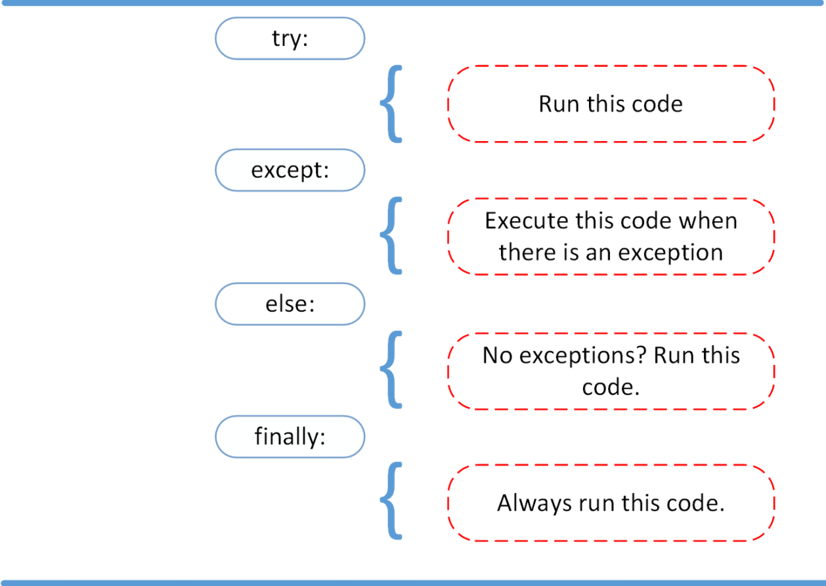
Python Exception Handle

Slide 3
Some Python Errors
Exception | Description
ZeroDivisionError | Raised when the second operand of division or modulo operation is zero.
ImportError | Raised when the imported module is not found.
IndexError | Raised when the index of a sequence is out of range.
KeyError | Raised when a key is not found in a dictionary
KeyboardInterrupt | Raised when the user hits the interrupt key Ctrl+C
TypeError | Occurs when you attempt to create an object of an interface or abstract class.
LookupError | This is the base class for those exceptions that are raised when a key or index used on a mapping or sequence is invalid or not found.

